Slide 1
Photosynthesis

Slide 2
Objectives of this lesson
To help students understand how the Earth is dependent on photosynthesis
To help students understand why photosynthesis is considered both a chemical and a biological process
To give students an understanding of the carbon cycle and how photosynthesis is essential for its continuation
To help students investigate some factors affecting photosynthesis
To give students an understanding of how knowledge of photosynthesis can be used to improve plant yields

Slide 3
Discussion: What gases is the air made from?

Slide 4
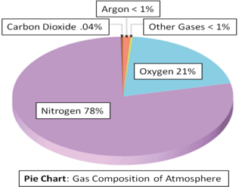

Slide 5
Identify the type of substances – Are they elements, compounds or mixtures
Nitrogen
Oxygen
Carbon dioxide

Slide 6
Discussion
1. How is oxygen on our planet kept at an adequate level?
2. How is the carbon dioxide level on our planet prevented from becoming poisonous?

Slide 7
The answer to both questions =Photosynthesis

Slide 8
Photosynthesis
Photo Synthesis
Where have you come across the word photo previously?
Notes:
PHOTO = LIGHT SYNTHESIS = TO PRODUCE/MAKE

Slide 9
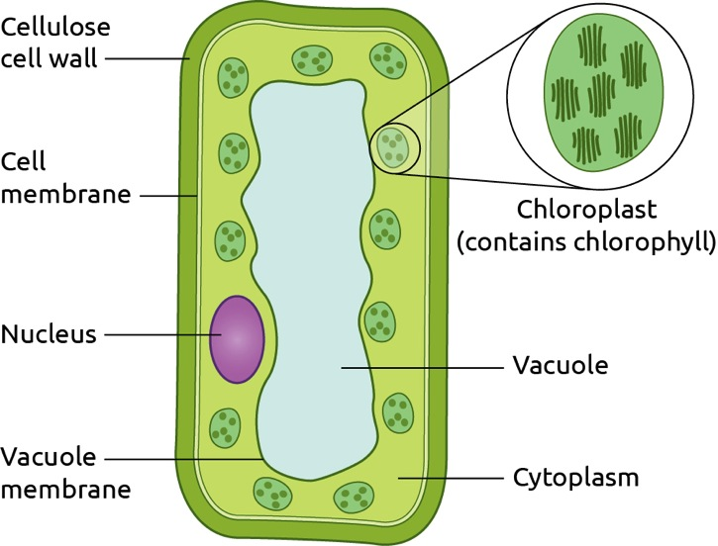
Photosynthesis is the way plants make their own food using light.
What special organelle in the plant cell is needed for plants to make their own food?

Slide 10
Two requirements for photosynthesis
1. Chlorophyll – present in the chloroplasts. They absorb the sunlight
2. Light – gives the energy necessary for the plant to make its own food

Slide 11
Learning Check
What is Photosynthesis?
What does the word photo refer to?
What does the word synthesis mean?
What organelle is needed for photosynthesis?
What two conditions are needed for photosynthesis?

Slide 12
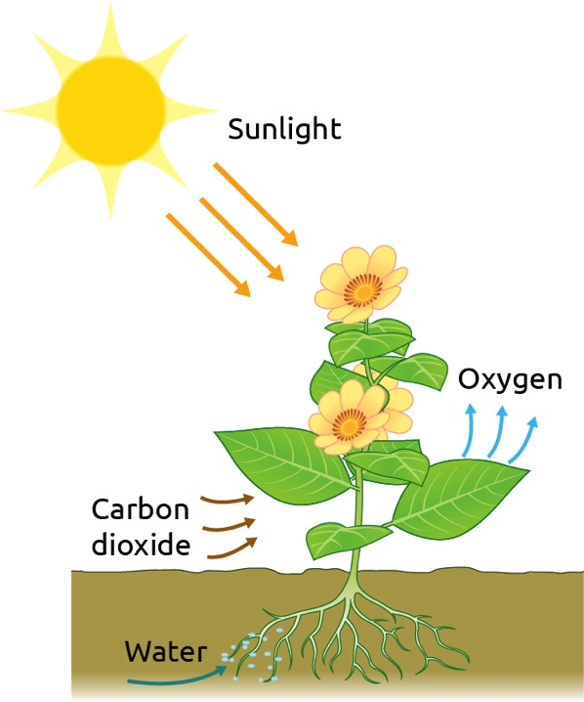
Carbon dioxide from the air enters a plant
Water enters a plant through the roots.
Sunlight energy is absorbed by chloroplasts in the leaves.
Chlorophyll, with the energy from the sunlight, allows carbon dioxide
to combine with water to form glucose (sugar)
Oxygen is the released into the atmosphere

Slide 13
Equation for Photosynthesis
chlorophyll
carbon dioxide + water glucose + oxygen
sunlight

Slide 14
Learning Check
What gas do plants take into their leaves?
What pigment in plant cells absorbs sunlight?
What is absorbed from the soil by the roots of the plant?
What does the sunlight provide?
What is made by the plant?
What gas is released into the atmosphere?

Slide 15
Activity: Investigating Photosynthesis
Sprig of Elodea or Cabomba into a graduated cylinder (250cm3)
Add 1% solution of sodium hydrogen carbonate and fill the graduated cylinder
Using a blade cut the stem of the plant at the angle while it is under the surface of the solution
Place the cylinder near a lamp and allow a few mins for the plant to adjust to the light
Observe and record bubbles of oxygen being produced
Notes:
ACTIVE SCIENCE PAGE 381

Slide 16
Show video – photosynthesis & plant structure
https://www.folensonline.ie/home/library/programmes/essential-science/resources/

Slide 17
End of lesson 1

Slide 18
Discussion: What is the importance of photosynthesis for our planet?

Slide 19
What is the importance of photosynthesis for our planet?
Photosynthesis maintains an adequate level of carbon dioxide by removing it from the air and preventing it from reaching poisonous levels
Photosynthesis provides oxygen which is essential for living organisms.
Food is provided for living organisms through the process of photosynthesis.

Slide 20
Card game photosynthesis

Slide 21
Experiment: To show that light is necessary for photosynthesis
Discussion – a possible method for carrying out this experiment?

Slide 22
Experiment: To show that light is necessary for photosynthesis
In this experiment we will test a plant’s leaves for starch after some of the leaves have been exposed to light and some are covered to avoid light
The reason we test the leaves for starch and not glucose is that as soon as a plant makes glucose in photosynthesis it is immediately converted to starch

Slide 23
Title of Experiment | Method | Hypothesis | Result
To show that light is necessary for photosynthesis

Slide 24
Method
A plant is placed in total darkness for 48 hours to get rid of any starch in its leaves. A leaf may be tested at this point to show the absence of starch
The plant is removed from the darkness and immediately some of the leaves are completely covered with aluminium foil
The plant is exposed to bright light for at least 6 hours
A covered lead and an uncovered leaf are then tested for the presence of starch

Slide 25
To test a leaf for starch
The leaf is placed in boiling water to kill it and soften it
The leaf is placed in warm alcohol to remove the chlorophyll
The leaf is put back in the hot water to wash off the alcohol
The leaf is placed on a white tile and iodine is dropped onto it

Slide 26
Result
The iodine on the leaf exposed to light will turn blue-black
The iodine on the covered leaf will stay an orange-brown colour
Conclusion
Light is required for photosynthesis

Slide 27
Learning Outcomes
At the end of this lesson students should be able to
Explain how the Earth is dependent on photosynthesis
Explain photosynthesis
Describe an experiment to show that light is necessary for photosynthesis

