Slide 1
The circulatory system

Slide 2
Objectives of this lesson
To help students to describe the composition of blood and its functions
To help students to show, name and describe the functions of the organs of the circulatory system
To show students how the organs of the circulatory system work with each other and other systems

Slide 3
Write down the meaning of the two words – Circulatory System

Slide 4
What is the circulatory system?
The circulatory system is a system of organs that allows blood to transport substances to the cells of the body.
It also transports wastes away from the cells

Slide 5
Discuss – Why do we need a circulatory system?

Slide 6
Why do we need a circulatory system?
Cells require food and oxygen to release energy.
Our cells also need to get rid of waste products such as carbon dioxide and water.
The circulatory system transports food (from the digestive system) and oxygen (from the respiratory system) to all the cells in our body.
Food and oxygen travel in our blood to the cells.
Wastes like carbon dioxide and water travel in the blood from the cells to the lungs and kidneys.

Slide 7
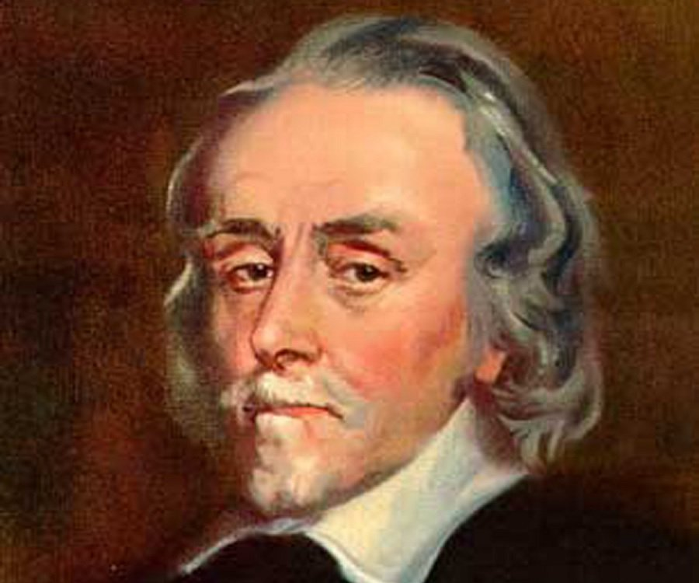
William Harvey (1578-1657) an Englishman, was born in Folkestone, Kent. He was the first to adequately describe the way blood flows around the human body.

Slide 8
Blood
Blood is a tissue. ( A Tissue is a group of cells with a similar function)
Blood is made up of a straw-coloured liquid called plasma and blood cells

Slide 9
Blood
Plasma is made of 90% water. Blood cells and food are carried in the plasma. Heat transferred throughout the body by the plasma also.
There are three types of blood cells floating in the plasma – red blood cells, white blood cells and platelets

Slide 10
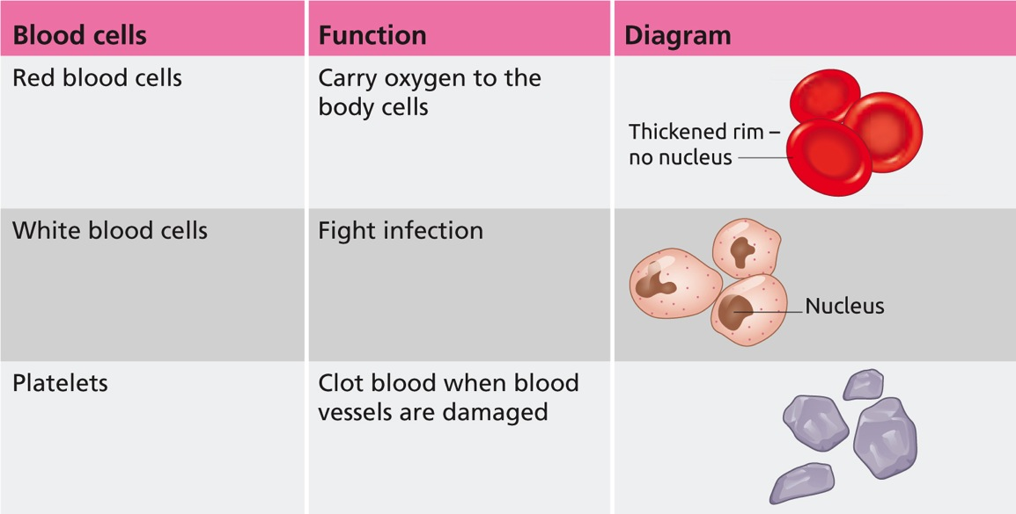
The blood cells in the plasma:

Slide 11
How do the blood cells carry out their functions?
1. Red Blood cells have a red pigment (colour) called haemoglobin which allows the oxygen to attach to red blood cells. Oxygen is then transported around the body
2. White blood cells – these fight infection by engulfing bacteria
3. Platelets – play an important role in the clotting of blood whenever a blood vessel gets damaged. This clot prevents blood from escaping.

Slide 12
Composition of Blood
Red Blood Cells
White Blood Cells
Plasma
Platelets

Slide 13
Journey of a blood cell
Imagine that you are a red blood cell. Write a story about the journey you take around the body, describing what you see as you make your way through the blood vessels. Describe your role as an oxygen an oxygen carrier. Be descriptive.

Slide 14
Using your knowledge of blood, list the functions of blood

Slide 15
Functions of the blood
Functions of blood
To transport oxygen to cells
To transport food to cells
To transport waste away from cells
To help fight infection
To help keep the body at the correct temperature
Notes:
It would be suggested that students should be able to link oxygen (lungs) and food (digestion) back to respiration, which would show interconnectivity between body systems.
Students should also be able to link waste back to excretion as water is transferred to the kidneys, and water and carbon dioxide are transported to the lungs.
There is a possibility also to introduce the concept of homeostasis here

Slide 16
Learning Check
What is blood composed of?
What is the liquid part of blood called?
Name the 3 blood cells
What is the function of red blood cells?
What is the function of white blood cells?
What is the function of platelets?

Slide 17
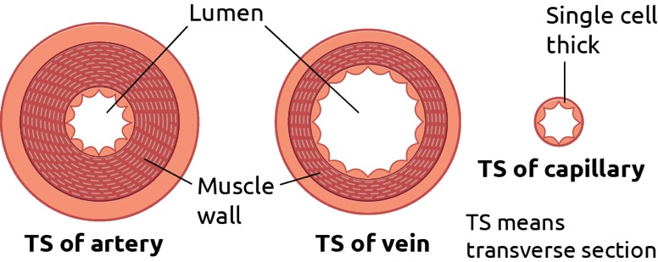
Blood Vessels
Blood vessels carry blood around the body
There are three types of blood vessels
Arteries
Veins
Capillaries

Slide 18
Arteries have thick walls that are very strong. Arteries always carry blood away from the heart
Veins have thinner walls and are easier than arteries to damage Veins always carry blood towards the heart.
Capillaries have walls that are only one cell think.

Slide 19
VEAL
Veins
Enter the heart
Arteries
Leave the heart

Slide 20
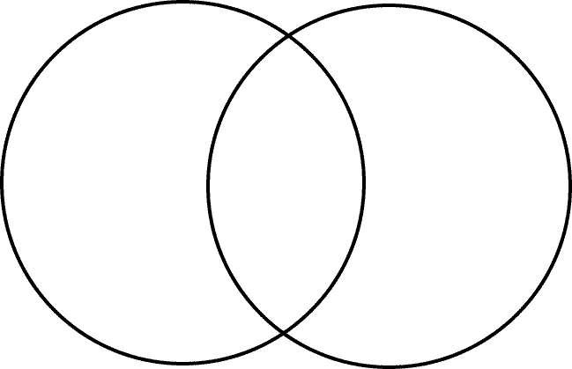

Slide 21
Valves
Blood will not flow backwards in arteries because the blood is under pressure from the hearts pumping action
However, the blood in veins is not under any pressure and therefore is in danger of flowing backwards
To prevent this from happening there are valves in veins to prevent backflow

Slide 22
Learning Check
What is the function of arteries?
What is the function of veins?
List 3 differences between arteries and veins?
What is the function of valves?

Slide 23
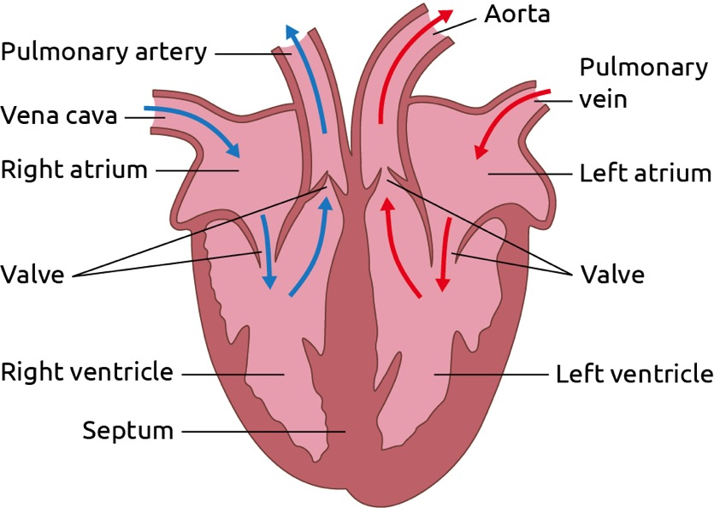
The Heart
The heart is made of 4 chambers
Notes:
SHOW MODEL OF HEART

Slide 24
Draw diagram of the heart

Slide 25
Learning Check
List the four chambers in the heart
Name the veins in the heart
Name the arteries in the heart
What is the function of valves

Slide 26
The Heart
The hearts is an organ made of a unique type of muscle known as cardiac muscle
Unlike the muscles on the skeleton, cardiac muscle never tires
The function of the heart is to transport oxygen rich blood around the body
It also sends deoxygenated blood to the lungs to remove carbon dioxide and collect oxygen
Notes:
EARTHWORMS HAVE 10 HEARS, FIVE ON EACH SIDE OF THEIR BODIES

Slide 27
The Pulmonary artery and the aorta are arteries. They bring blood away from the heart.
The vena cava and the pulmonary vein are veins. They bring blood towards the heart
The vena cava brings oxygen rich blood from the body. The pulmonary artery transports this deoxygenated blood to the lungs
The pulmonary vein brings oxygen rich blood from the lungs. The aorta transports this oxygenated blood around the body

Slide 28
Right side of the heart
Blood enters right atrium through the vena cava.
Right atrium contracts, squeezing blood into right ventricle.
Right ventricle contracts, forcing blood into pulmonary artery.
Pulmonary artery carries blood away from the heart and to the lungs.
Left side of the heart
Blood enters left atrium through pulmonary vein.
Left atrium contracts, squeezing blood into left ventricle.
Left ventricle contracts, forcing blood into aorta.
Aorta carries blood away from the heart and to the rest of the body.

Slide 29
Learning Check
What type of muscle is the heart made of?
Why is the left ventricle much thicker than the right ventricle?
What is the function of the vena cava?
What is the function of the pulmonary artery?
What is the function of the aorta?
What is the function of the pulmonary vein?

Slide 30
Why does exercise increase heart rate ?
Notes:
DISCUSSION

Slide 31
Why does exercise increase heart rate ?
We need energy to exercise.
We get this energy from respiration.
But respiration needs oxygen.
So …
The more we exercise, the more energy we need, thus the more oxygen we need.
To get more oxygen, our heart pumps faster so the blood can deliver the oxygen more quickly to the cells.

Slide 32
Worksheet – matching terms exercise

Slide 33
Experiment: To investigate the effect of exercise on heart rate
A pulse is a vibration in an artery due to the beat of the heart
1. locate the pulse using your index and middle fingers being placed on the wrist at the base of the thumb
2. Count the beats and use a stopwatch
3. Calculate the pulse rate: the number of pluses counted in 30 seconds is multiplied by 2 to get the pulse rate

Slide 34
Learning outcomes
At the end of this lesson you should be able to:
Recall what makes up blood
Differentiate between artery, vein and capillary
Describe the structure of the heart
Describe the flow of blood through the heart

