Slide 1
The Respiratory System

Slide 2
Objectives of this lesson
To help students explain how breathing happens
To help students to show, name and describe the functions of the respiratory system
To show students how the organs of the breathing system work with each other and other systems

Slide 3
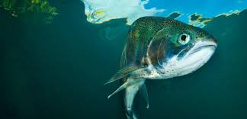
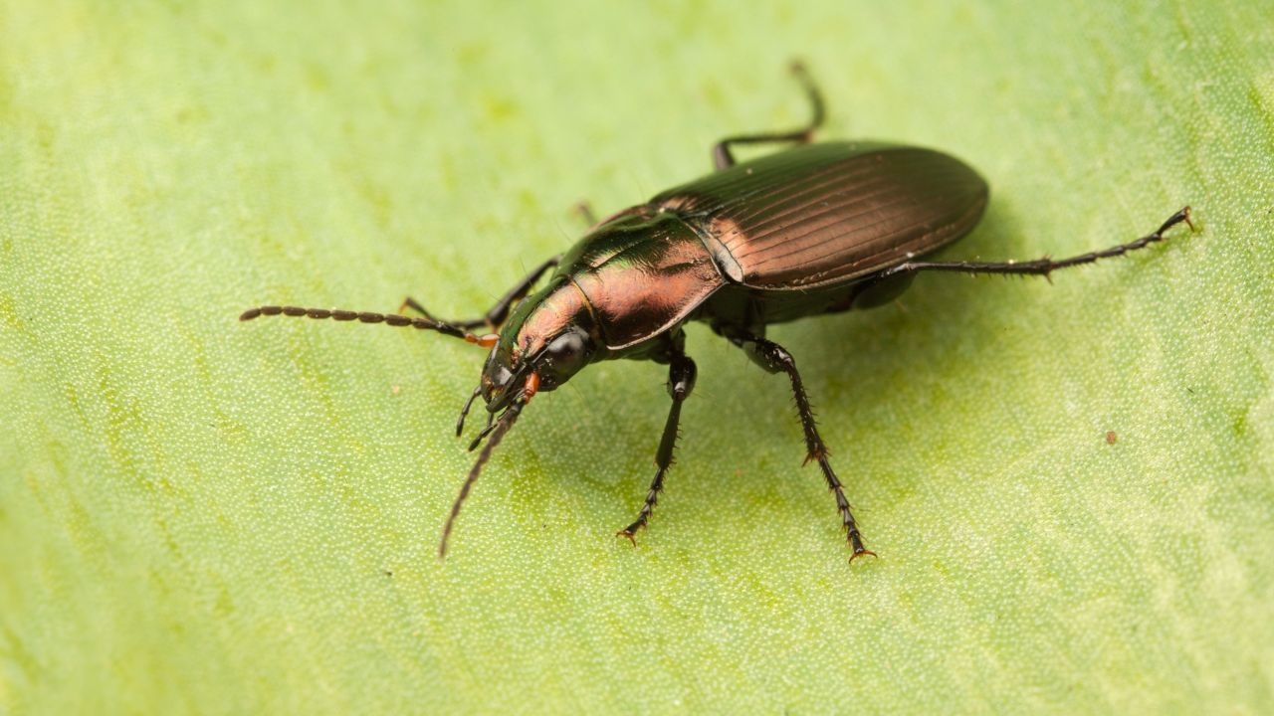
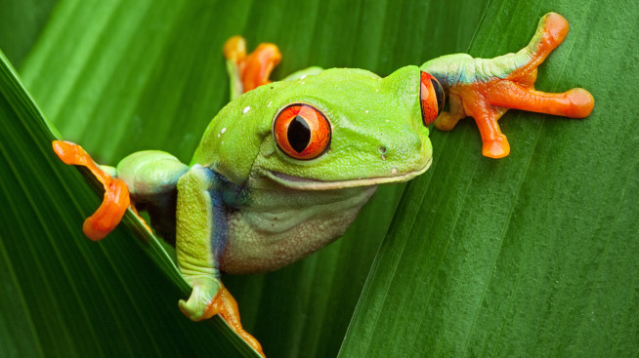
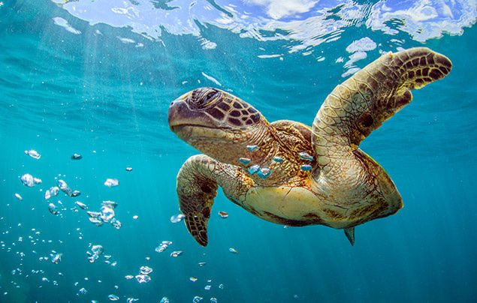
Different organisms breathe in different ways
Notes:
Insects breathe through lots of holes in their sides. Amphibians breathe through their skin. Fish breathe through their gills. Most turtles can hold their breathe for over 30 minutes, however some can breathe through a hole located at their underside that is used for excretion!

Slide 4
Discussion: Why is Breathing important?

Slide 5
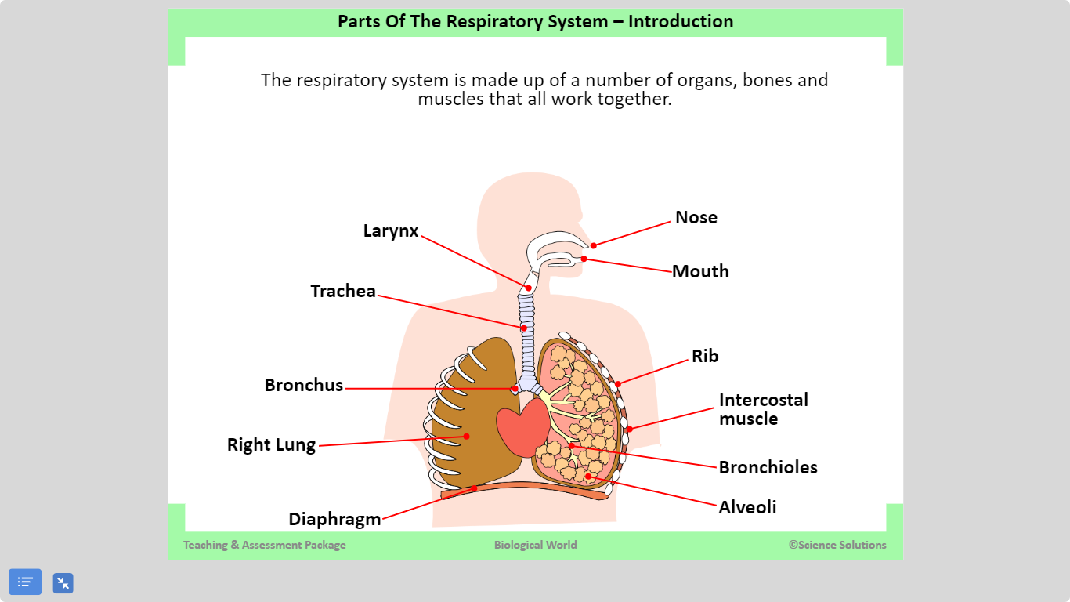

Slide 6
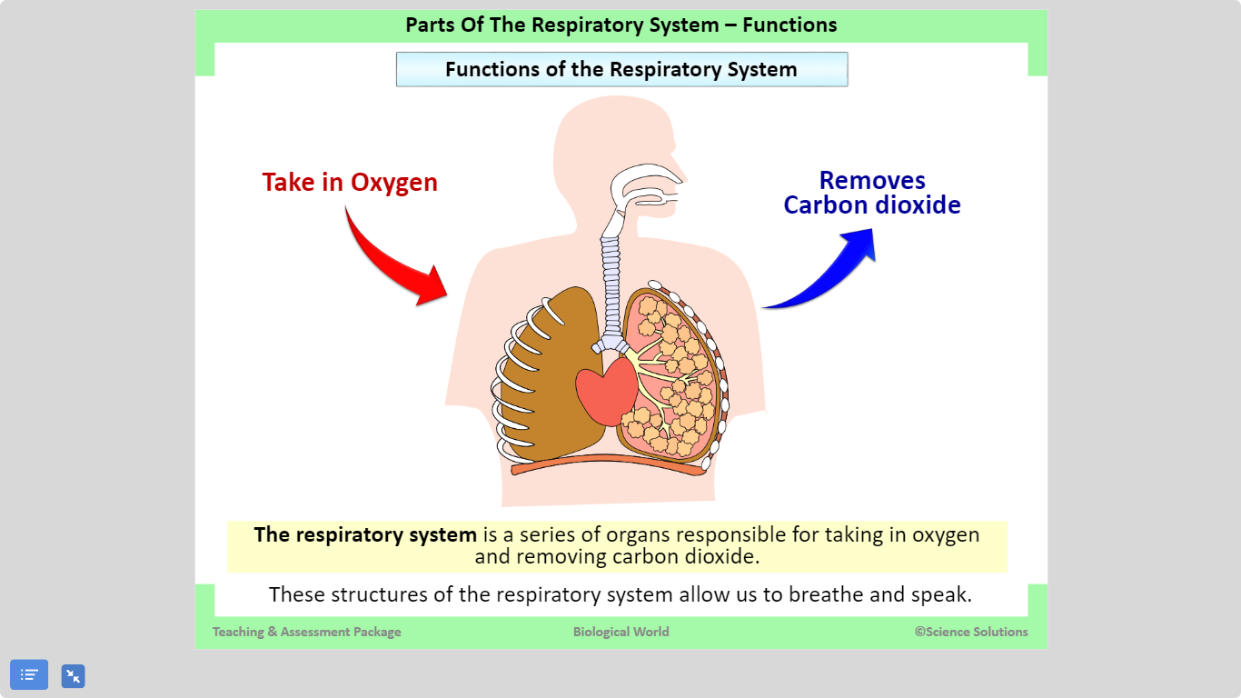

Slide 7
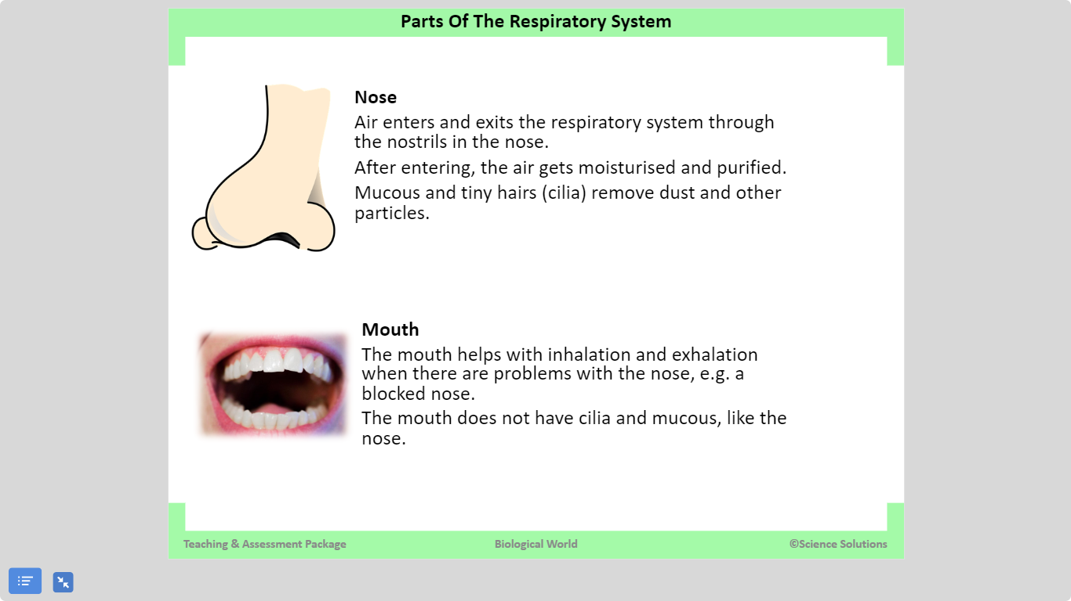

Slide 8
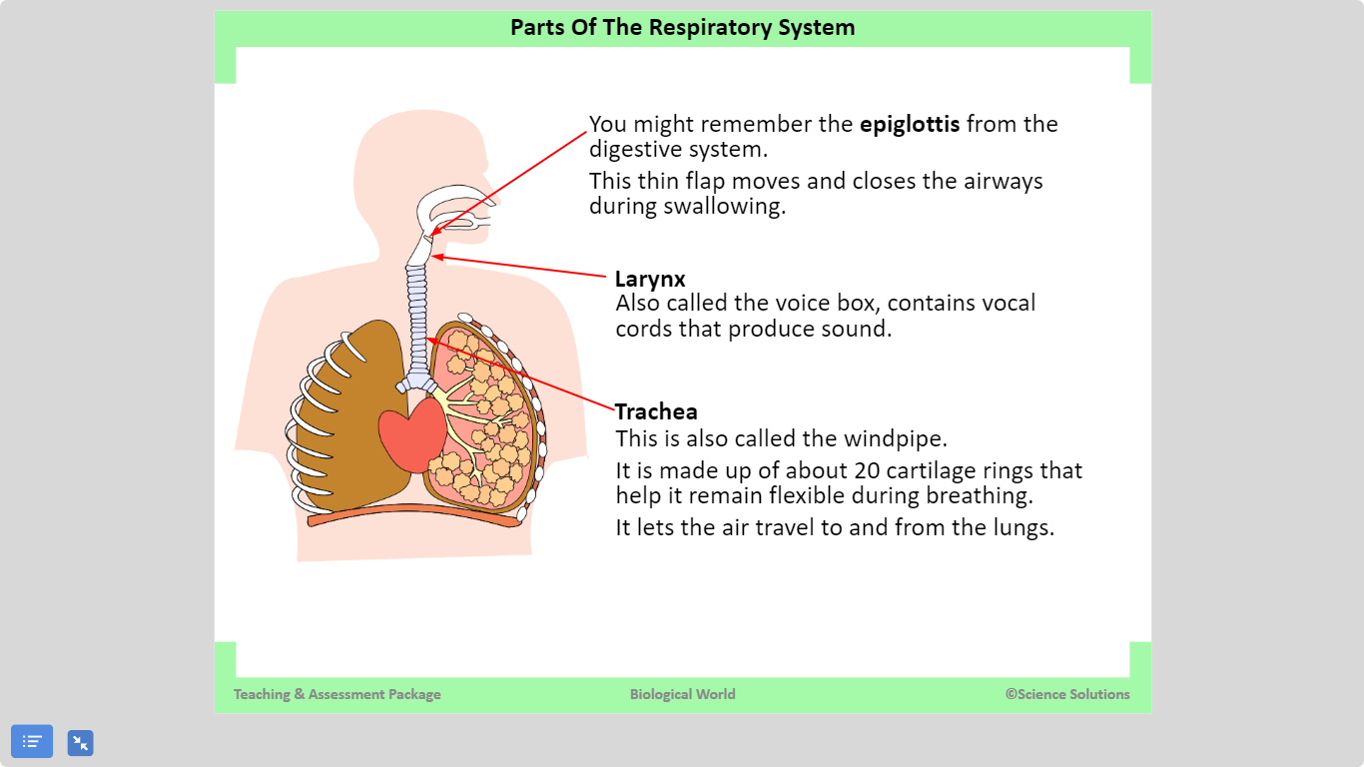

Slide 9
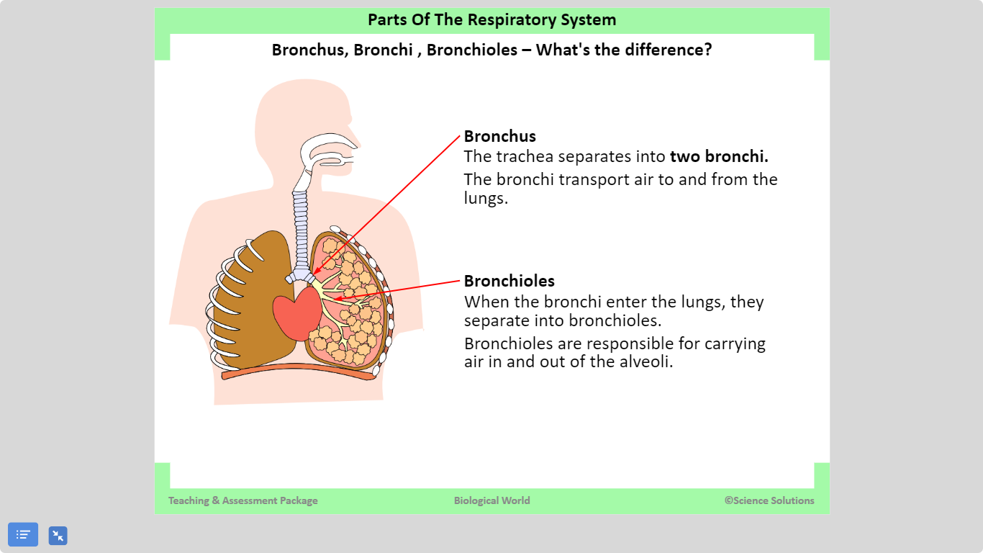

Slide 10
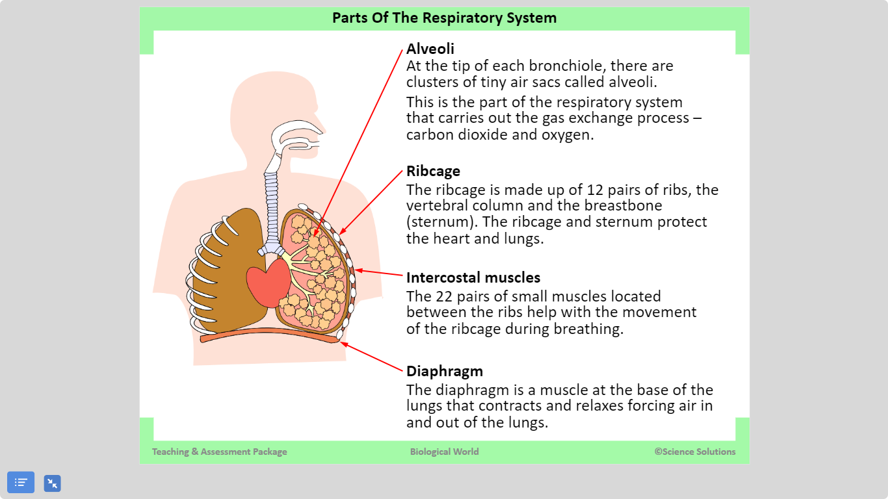

Slide 11
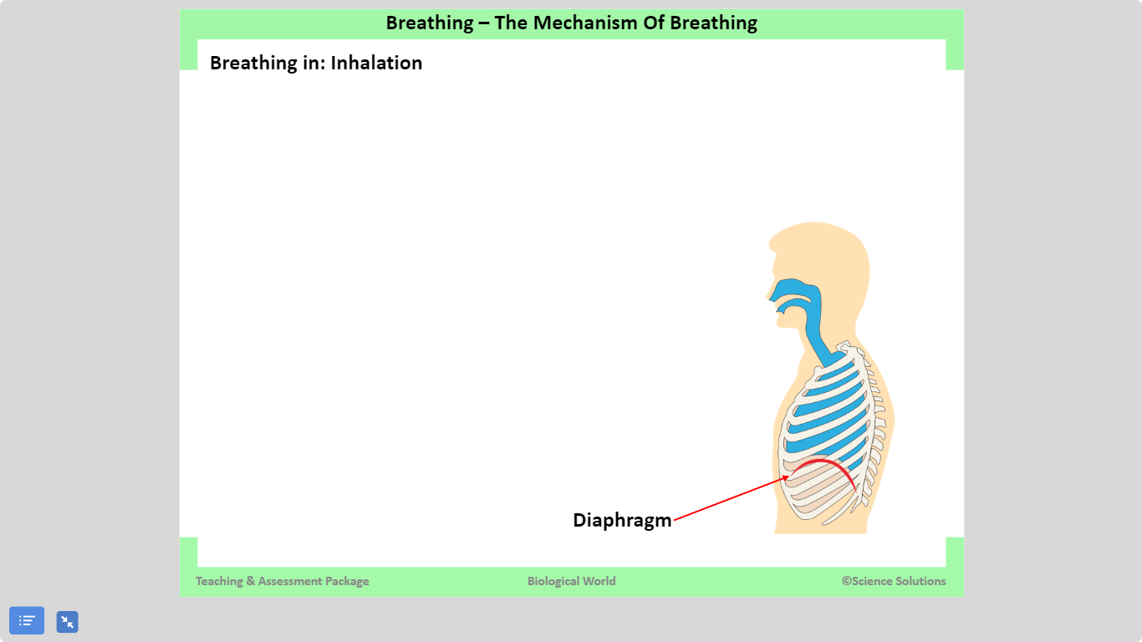

Slide 12
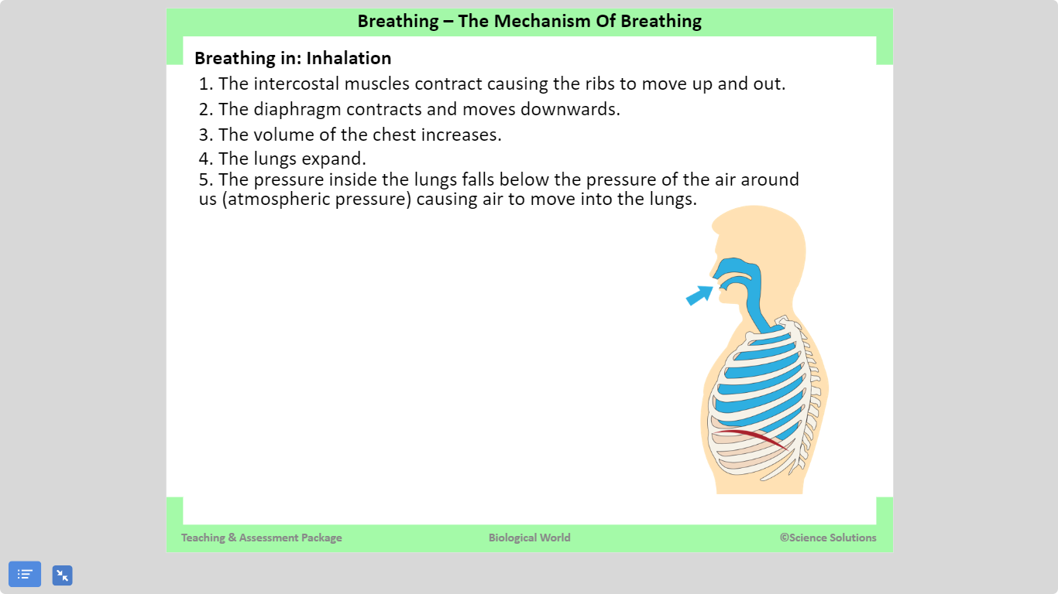

Slide 13
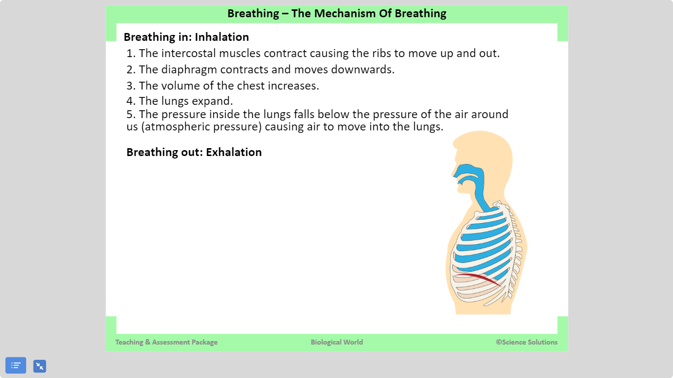

Slide 14
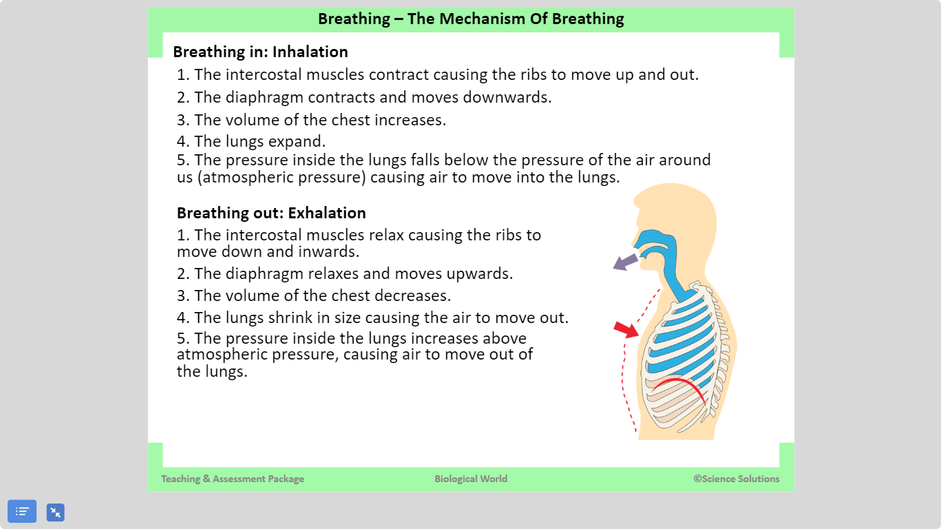

Slide 15
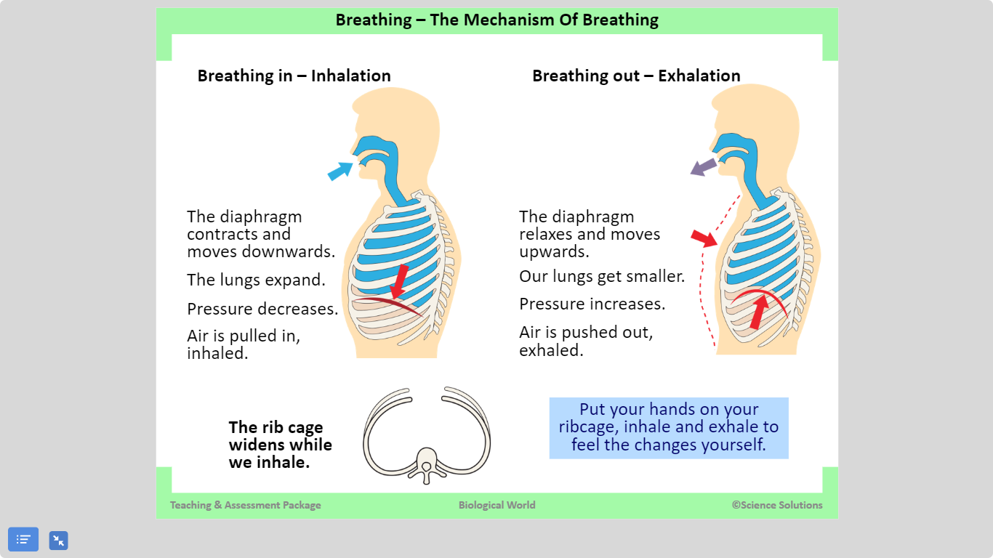

Slide 16
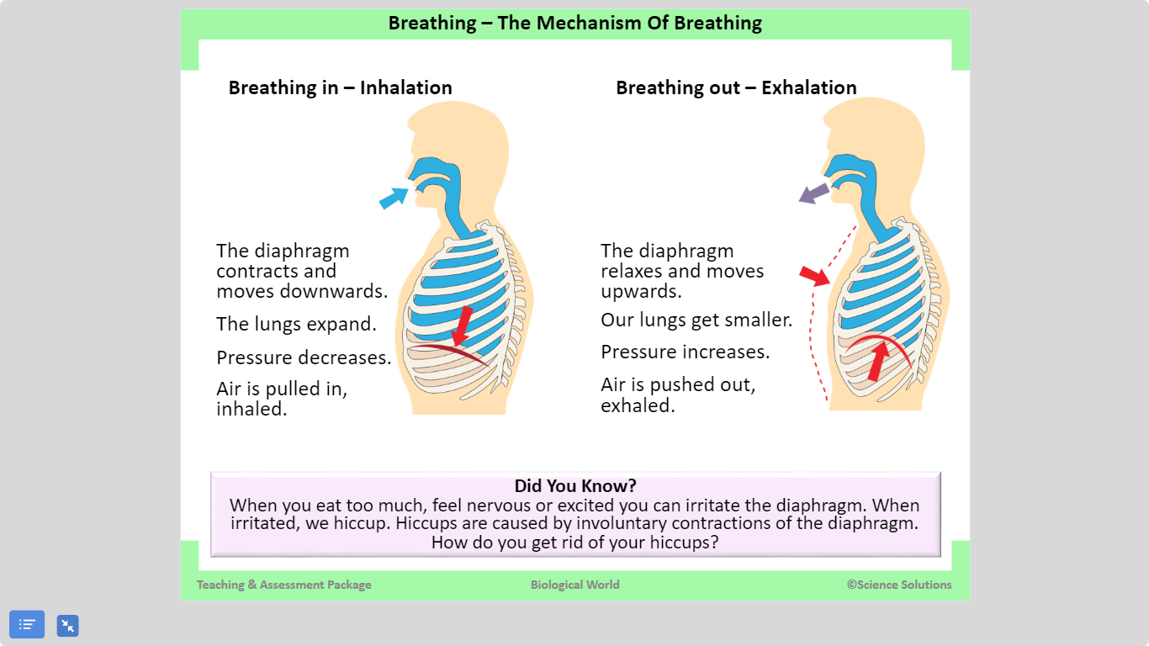

Slide 17
Why do we need a respiratory system?
Respiration is the release of energy from food.
This takes place in the cells of our body.
We need oxygen (in most cases) for respiration to occur.
Our respiratory system provides oxygen to the body so respiration can occur.
In humans this is also called breathing

Slide 18
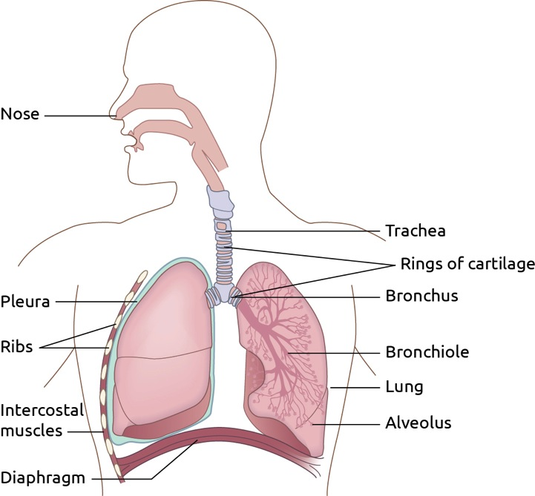
Notes:
Air enters through the nose, travels down the trachea into the bronchus, then into the bronchiole and finally the air enters the alveoli.
It can be introduced also that the trachea, bronchus, bronchiole are supported by rings of cartilage.

Slide 19
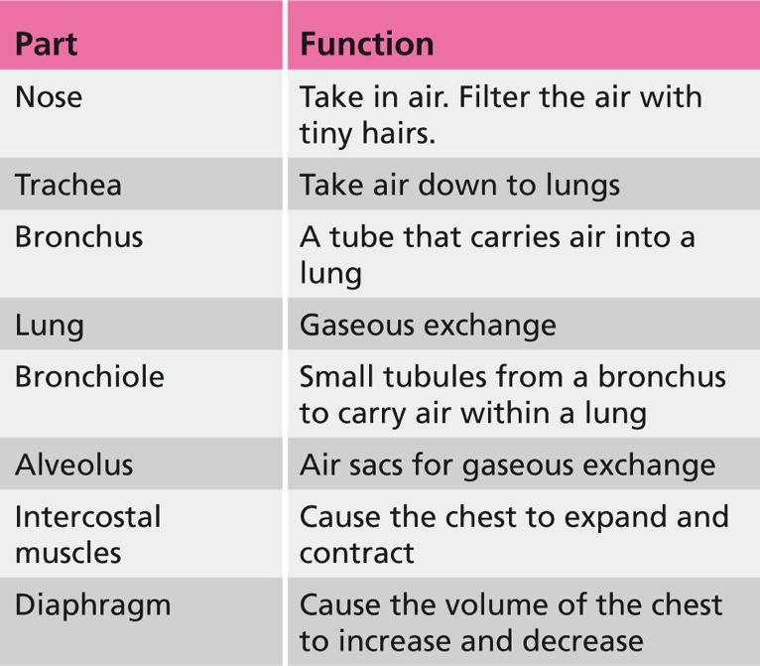

Slide 20
Learning check
What is respiration
Why do we need a respiratory system?
What is the function of (a) The Lungs (b) The alveoli (c) The diaphragm (d) the rings of cartilage

Slide 21
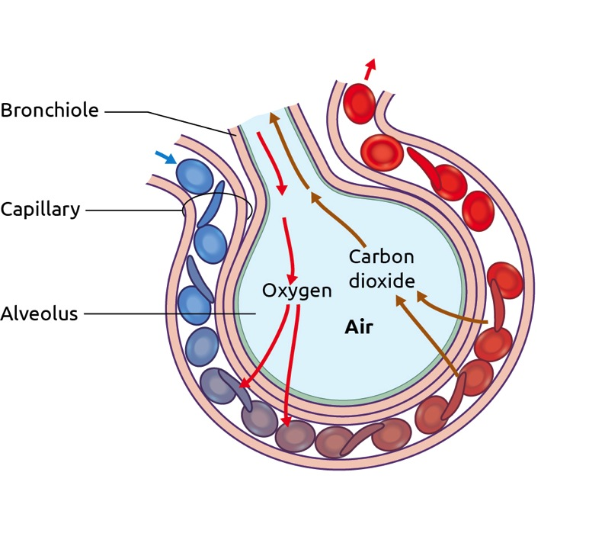
Gaseous Exchange
It is estimated that there are around 300 million alveoli in each lung
They have very thin walls and are surrounded by extremely thin-walled capillaries
The oxygen in the alveoli moves through their walls and through the walls of the capillaries into the blood
The carbon dioxide in the blood of the capillaries moves through their walls and through the walls of the alveoli into the inside of the alveoli
This movement of gas is called diffusion

Slide 22
Learning check
What are alveoli ?
What are capillaries?
Fill in the blanks:
___________ enters the alveoli and moves through their _____ walls. The _________ then enters the capillaries and into our ______
_______ _________ in the blood moves through the capillaries into the ________ and eventually out of our body

Slide 23
Fill in the blanks worksheet

Slide 24
T investigate if vertebrates produce carbon dioxide
Blow into a test tube of limewater.
Is Carbon dioxide produced?

Slide 25
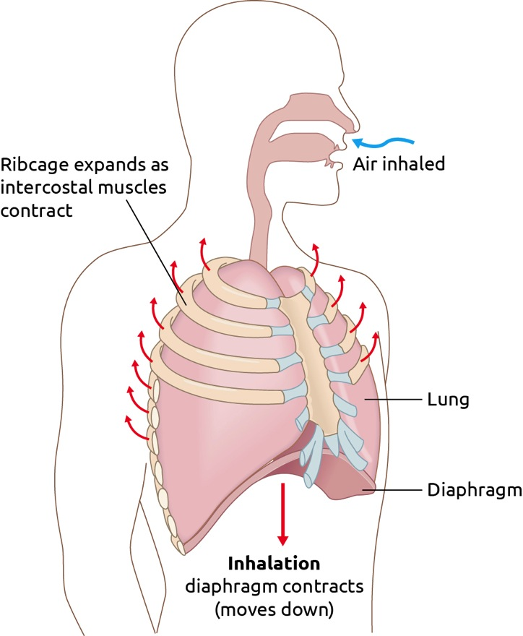
Breathing in
Intercostal muscles contract, causing ribs to move up and out.
Diaphragm contracts, causing it to move down.
These steps increase the volume of the ribcage.
The pressure in the lungs decreases.
Air is sucked in.
Air we breathe in is called Inhaled air

Slide 26
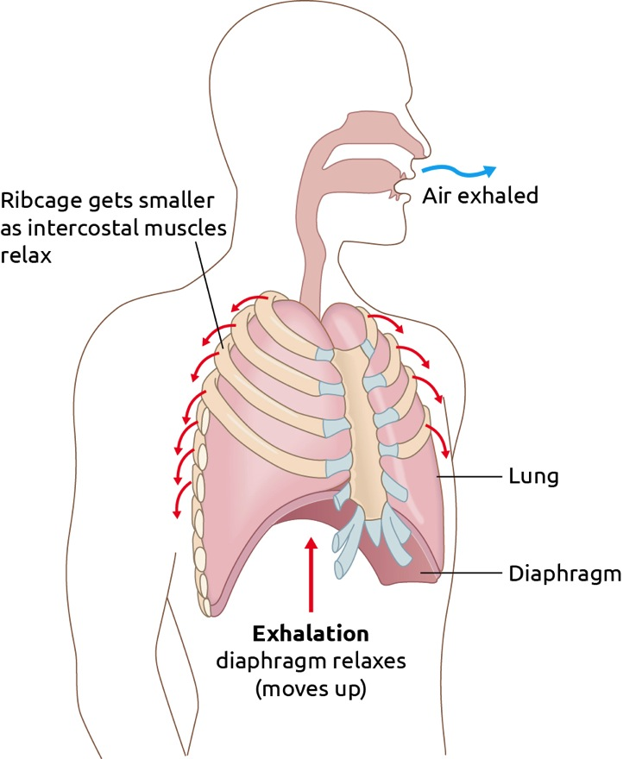
Breathing out
Intercostal muscles relax, causing ribs to move down and in.
Diaphragm relaxes, causing it to arch up.
These steps decrease the volume of the ribcage.
The pressure in the lungs increases.
Air is forced out.
Air we breathe out is called exhaled air

Slide 27
Breathing system card game

Slide 28
Experiment: To investigate carbon dioxide in inhaled air and exhaled air
Limewater is a colourless liquid which turns milky when carbon dioxide is added to it
In this experiment you will breathe air in through a test tube of limewater and breathe the same air out into a different test tube of limewater. You will find out which limewater turns milky first and so find out whether the air you breathe in or the air you breathe out has the most carbon dioxide in it

Slide 29
Equipment required
Test tubes x 2
Glass tubing x 4
Two-holed rubber stoppers x 2
Limewater

Slide 30
Breaths per minute
The number of breaths we breathe per minute depends on our age and activity level.
If you exercise, your body will respire more.
More respiration will lead to more carbon dioxide (which is a waste product) being produced by your body.
Large amounts of carbon dioxide can be poisonous to our bodies.
Our breathing rate will increase as a result to get rid of carbon dioxide faster.

Slide 31
How the organs of the respiratory system interact with each other
Nose and lungs: These filter and moisten the air before it enters the alveoli.
Trachea, bronchi and bronchioles: These tubes work together to bring air down into the lungs and back up from the lungs. They have rings of cartilage supporting the tubes to keep them open.
Intercostal muscles and diaphragm: These work together. When the intercostal muscles and diaphragm contract (squeeze), air is drawn into the lungs. When the intercostal muscles and diaphragm relax,
air is pushed out of the lungs.

Slide 32
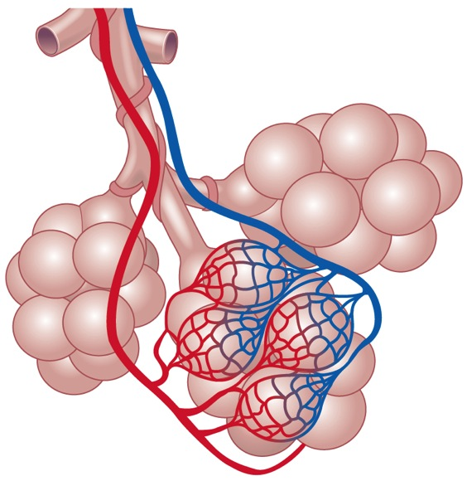
How the organs of the respiratory system interact with the organs of the circulatory system
Oxygen from air in the alveoli needs to enter the bloodstream.
To do this, blood is pumped by the heart through the pulmonary artery to the lungs.
This artery divides into tiny capillaries that surround each alveolus.
The oxygen can now move across the membrane of the alveolus and enter the blood.
Once oxygen is in the capillaries, they re-join to form the pulmonary vein.
This blood returns to the heart to be pumped around the whole body

Slide 33
Learning outcomes
Explain why respiration is important
Draw a labelled diagram of the respiratory system
Recall the functions of each of the parts of the respiratory system
Describe the gaseous exchange in the lungs
Recall the steps involved in breathing
Describe an investigation to show that there is more carbon dioxide in exhaled air than in inhaled air

